Slide 1

Target Markets

Slide 2
Marketing Applications
4.3
Target Markets
Before we examine target markets, we must first understand what determines a market
  The group of potential consumers who share common needs and wants
  That consumer group must have the ability and willingness to buy the product
  Businesses strive to meet the needs and wants of those consumers

Slide 3

Marketing Applications
4.3
Target Markets
A target market refers to people with a defining set of characteristics that set them apart as a group
Target
  The target is a specific group of consumers with a defining set of characteristics
  This market shares one or more similar and identifiable needs or wants

Slide 4

Marketing Applications
4.3
Target Markets Must Be:
Sizeable: The overall size of the market
    Market can have too many or too few consumers

Slide 5
Marketing Applications
4.3
Target Markets Must Be:
Measurable: Ability to measure size, accessibility and
overall purchasing power of the target market
Behavioral: Marketers seek to find similar behaviors
within each respective target market
      For example, motivation of buying for the corporate season ticket holder is different than for the individual season ticket holder

Slide 6

Marketing Applications
4.3
The Marketing Concept
Sports and entertainment organizations must have an understanding of their target market to create an effective marketing strategy that caters to their audience

Slide 7
Marketing Applications
4.3
The Marketing Concept
Target Market Influences
Diversity of consumer needs and wants
Organization size
Attributes of company products and/or services
Size and strength of competitors
Sales volume required for profitability

Slide 8



Marketing Applications
4.3
The Marketing Concept
Because Sprint’s target market is shifting toward college students, the company chose to invest in a sponsorship (includes presenting rights) to a college football game pitting Notre Dame against Maryland at FedEx Field in 2012

Slide 9

Marketing Applications
4.3
The Marketing Concept
Part of Coca-Cola’s marketing strategy is to target moms. As such, the soft drink giant rolled out a comprehensive marketing campaign tied to the 2012 Olympic Games based on the knowledge that the Olympics traditionally attract more female viewers than almost any other sporting event.

Slide 10
Marketing Applications
4.3
Niche Marketing
Niche Marketing:
Process of carving out a relatively tiny part of a market that has a very special need not currently being filled
Niche Marketing offers a unique opportunity to consumers or one that has not been offered in the past

Slide 11

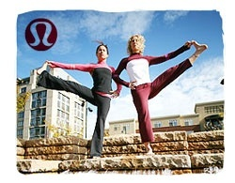

Marketing Applications
4.3
Niche Marketing
Lululemon Athletica is a Canadian retailer that distributes product in Canada and the United States. The company targets its branded yoga and fitness apparel to a niche consumer of female athletes.

Slide 12



Marketing Applications
4.3
Niche Marketing
Lululemon, positioned as a high-end brand, has enjoyed explosive growth in the past several years (in 2012 they were named the 7th most valuable brand in Canada. On the heels of their success, Under Armour has introduced a new yoga line, Gap introduced its GapBodyFit line, Forever 21 began selling active wear and both Nordstrom and Target expanded their store branded women’s sportswear offerings (even lingerie company Victoria’s Secret now sells yoga pants).

Slide 13

Marketing Applications
4.3
Niche Marketing
When Lululemon was forced to recall product in 2013 because they were see through when stretched, Under Armour (who has been targeting women as a key demographic for several years), responded by featuring the tag line "We've Got You Covered” on its Facebook page in an effort to drive customers to its site
Click here for a story on dailyfinance.com to see how other competitors (including Nike, a new player in the yoga field) have responded

Slide 14






Marketing Applications
4.3
Niche Marketing
Cable television channels often seek niche audiences to appeal to specific target groups with a common set of interests, such as ESPN designing programming to appeal to sports fans

Slide 15

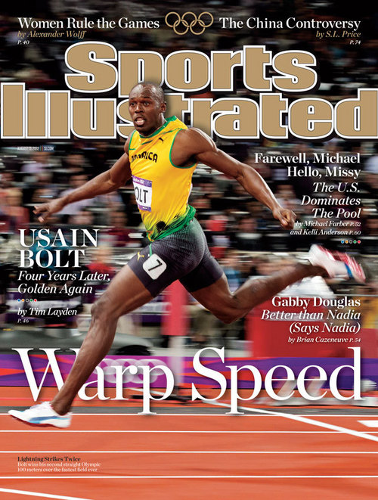
Marketing Applications
4.3
Niche Marketing - Discussion
Magazines seek niche audiences to appeal to a specific target group that has a common set of interests, such as Sports Illustrated launching a sports-specific magazine to appeal to sports fans

Slide 16

Marketing Applications
4.3
Niche Marketing - Discussion
When a business sees a competitor enjoying success with a particular niche, often times the market can become flooded with other companies exploiting the same niche or another similar niche.
How has that affected Sports Illustrated since it first launched the magazine in 1954?

Slide 17
Marketing Applications
4.3
Niche Marketing - Discussion
Has the niche audience of sports fans spawned additional niche opportunities for Sports Illustrated?
Offer specific examples to support your answers.

Slide 18
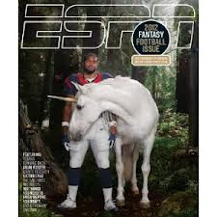
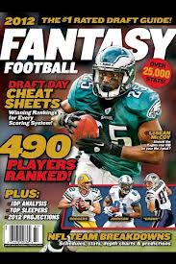
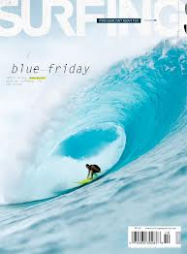



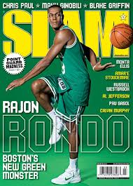
Marketing Applications
4.3
Niche Marketing - Discussion

Slide 19
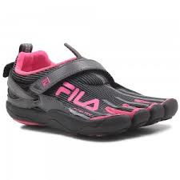
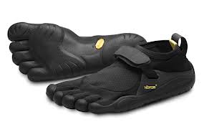
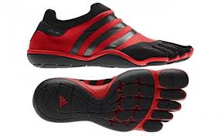
Marketing Applications
4.3
Niche Marketing
As the running category continues to gain steam (sales of running shoes were up 14% in the last year), brands like Vibram and their “five finger shoes”, Fila with skeletoes, and Adidas with adiPURE (among others) have carved a niche with “minimalist” running shoes, designed to create a “barefoot” jogging experience while still providing protection for the feet

Slide 20

Marketing Applications
LESSON 4.3
Copyright © 2013 by Sports Career Consulting, LLC

Slide 21
Marketing Applications
LESSON 4.3
Niche Marketing
However, not all niche markets last. For the first quarter of 2013, sales were of the minimalist shoe were down 10% while motion control shoes were up 25% (another niche in the running category). Said Matt Powell in an interview on runnersworld.com, "It appears this fad is pretty much over."
Copyright © 2013 by Sports Career Consulting, LLC

Slide 22
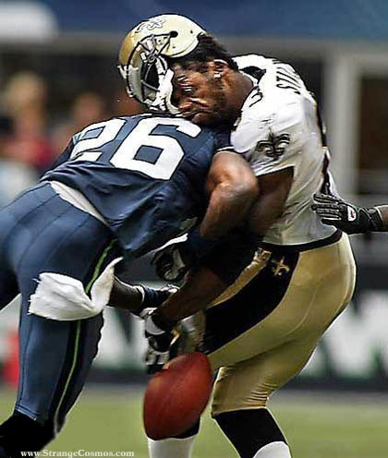

Marketing Applications
4.3
Niche Marketing
As the NFL begins to invest in research to curb the dangers of playing football, many entrepreneurs are taking note. In a story posted on Yahoo! Sports ’ website, about half the vendors at a 2013 sports conference were in some way involved with concussions.

Slide 23
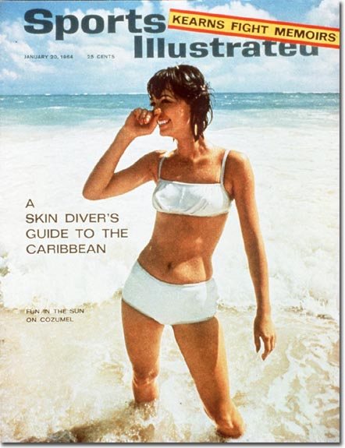
Marketing Applications
4.3
Niche Marketing
Sports Illustrated captured a lucrative niche market with the annual Swimsuit Issue. What started in 1964 as a five page supplement in February has grown into a multi-billion dollar specialty issue which has impact in fashion, travel, product placement and many additional marketing tie-ins.

Slide 24
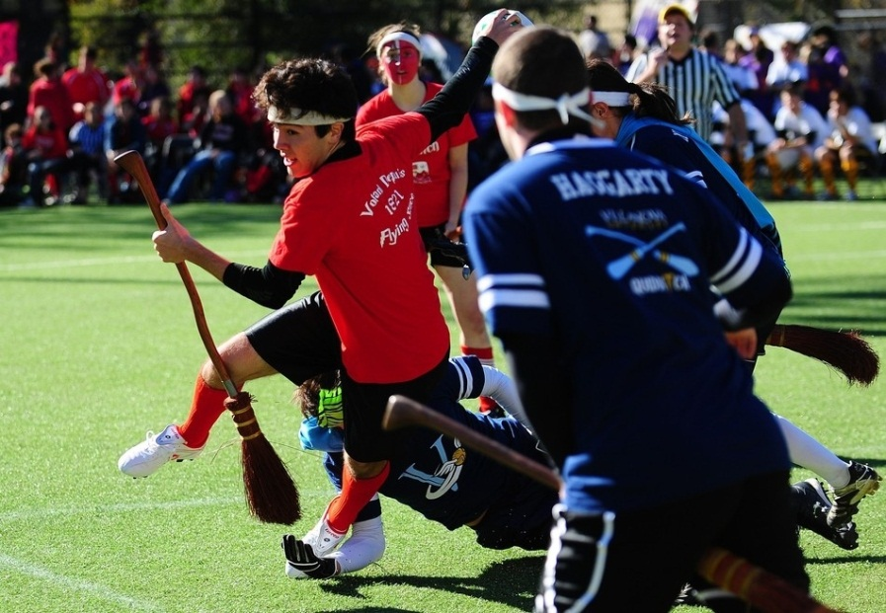

Marketing Applications
4.3
Niche Marketing
Niche can also be a term applied to a particular sport that is not considered to be “mainstream” (archery, many Olympic sports, beach soccer , arm-wrestling …even “Quidditch ”)

